Slide 1
Exploring the Mechanisms of Output Interference During Cued Recall Using Metamemory Judgments
Taylor Curley, PhD Air Force Research Laboratory taylor.curley@us.af.mil

Slide 2
Acknowledgements
I would like to thank several people, including:
Chris Hertzog (Georgia Tech)
Emily Lustig (Georgia Tech)
MacKenzie Hughes (Georgia Tech)
Rick Thomas (Georgia Tech)
John Dunlosky (Kent State)
Paul Verhaeghen (Georgia Tech)
Dobromir Rahnev (Georgia Tech)
Megan B. Morris (AFRL)
Leslie Blaha (AFRL)
Technical notes:
This project was part of a dissertation project at the Georgia Institute of Technology and funded in part by a Ruth L. Kirschstein National Research Service Award (NRSA) Institutional Research Training Grant (T32) from the National Institutes of Health (National Institute on Aging) Grant 5T32AG000175.
All code and figures were run using Julia and R, and this presentation was compiled using Quarto.
Most analyses can be found on OSF: osf.io/2eqv7.
Notes:
These are optional notes.

Slide 3
OVERVIEW

Slide 4
Memory Interference
Notes:
These are optional notes.

Slide 5
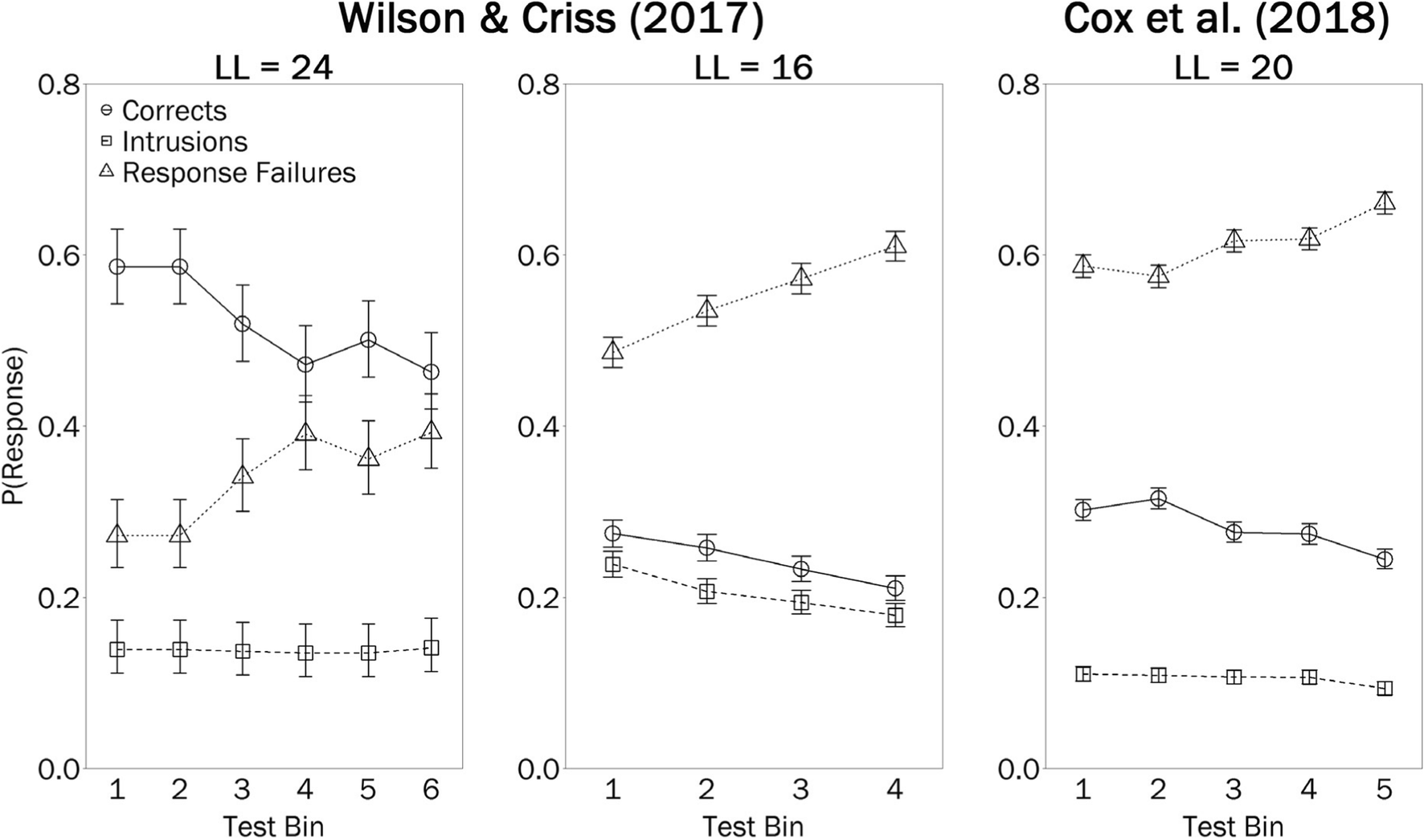
Output Interference
Notes:
These are optional notes.

Slide 6
Memory Awareness
Notes:
These are optional notes.

Slide 7
Feelings-of-knowing
Notes:
These are optional notes.

Slide 8
Current Study
Notes:
These are optional notes.

Slide 9
METHODS

Slide 10
Participants
CONDITION | N | M (age) | SE (age)
Related Cues | 49 | 20.24 | 0.57
Unrelated Cues | 36 | 19.73 | 0.25
Sample consisted of 85 college-aged students recruited from Georgia Tech’s research subject pool.
Random (blind) assignment to 2 between-subjects conditions:
Related Cues
Unrelated Cues
Notes:
These are optional notes.

Slide 11
Conditions
Unrelated | Related
NEEDLE - QUESTION | RAIN - MIRAGE
OUTSIDE - LOST | SLEET - EAST
POST - FROWN | SNOW - PRECISE
PULL - CRISP | LIGHTNING - CIRCLE
… | …
Individuals in the Unrelated Cues condition studied lists of 40 unrelated cue-target word pairs.
Individuals in the Related Cues condition studied 4 lists of 10 cue-target word pairs where the cue words were categorically-related, but unrelated to the target words.
Cue words were selected from 10 exemplars from 4 normative taxonomic categories (Van Overschelde et al., 2004).
The target words were unrelated to each other.
Example stimuli:
Notes:
These are optional notes.

Slide 12
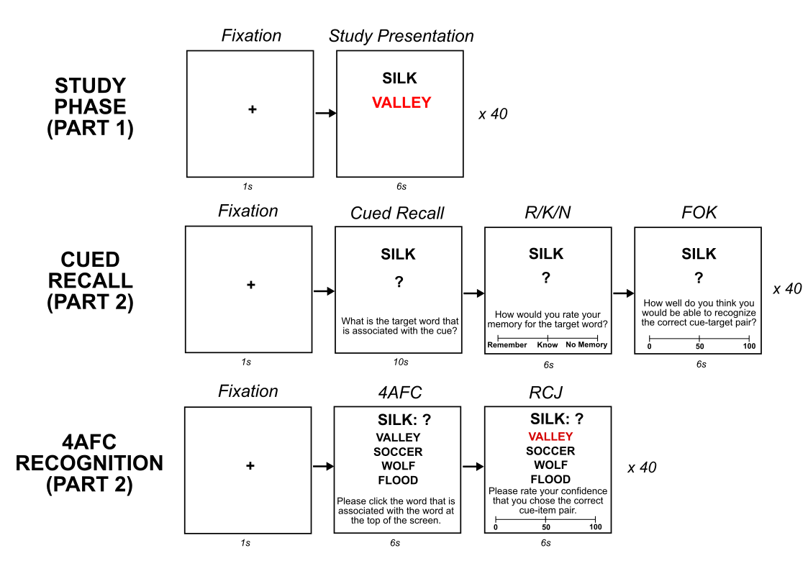
Procedure
Study
40 cue-target word pairs X 2.
Presented in random order.
Cued Recall
Cued recall attempt + R/K/N + FOK (0-100)
Related Cues: 4 blocks of 10 trials where cue words are from same category.
Unrelated Cues: 40 trials in random order.
Recognition
4AFC attempt + RCJ (0-100)
40 trials in random order.
Notes:
We presented the cue-target pairs twice (in 2 blocks) to bring recall accuracy off of floor.

Slide 13
RESULTS

Slide 14
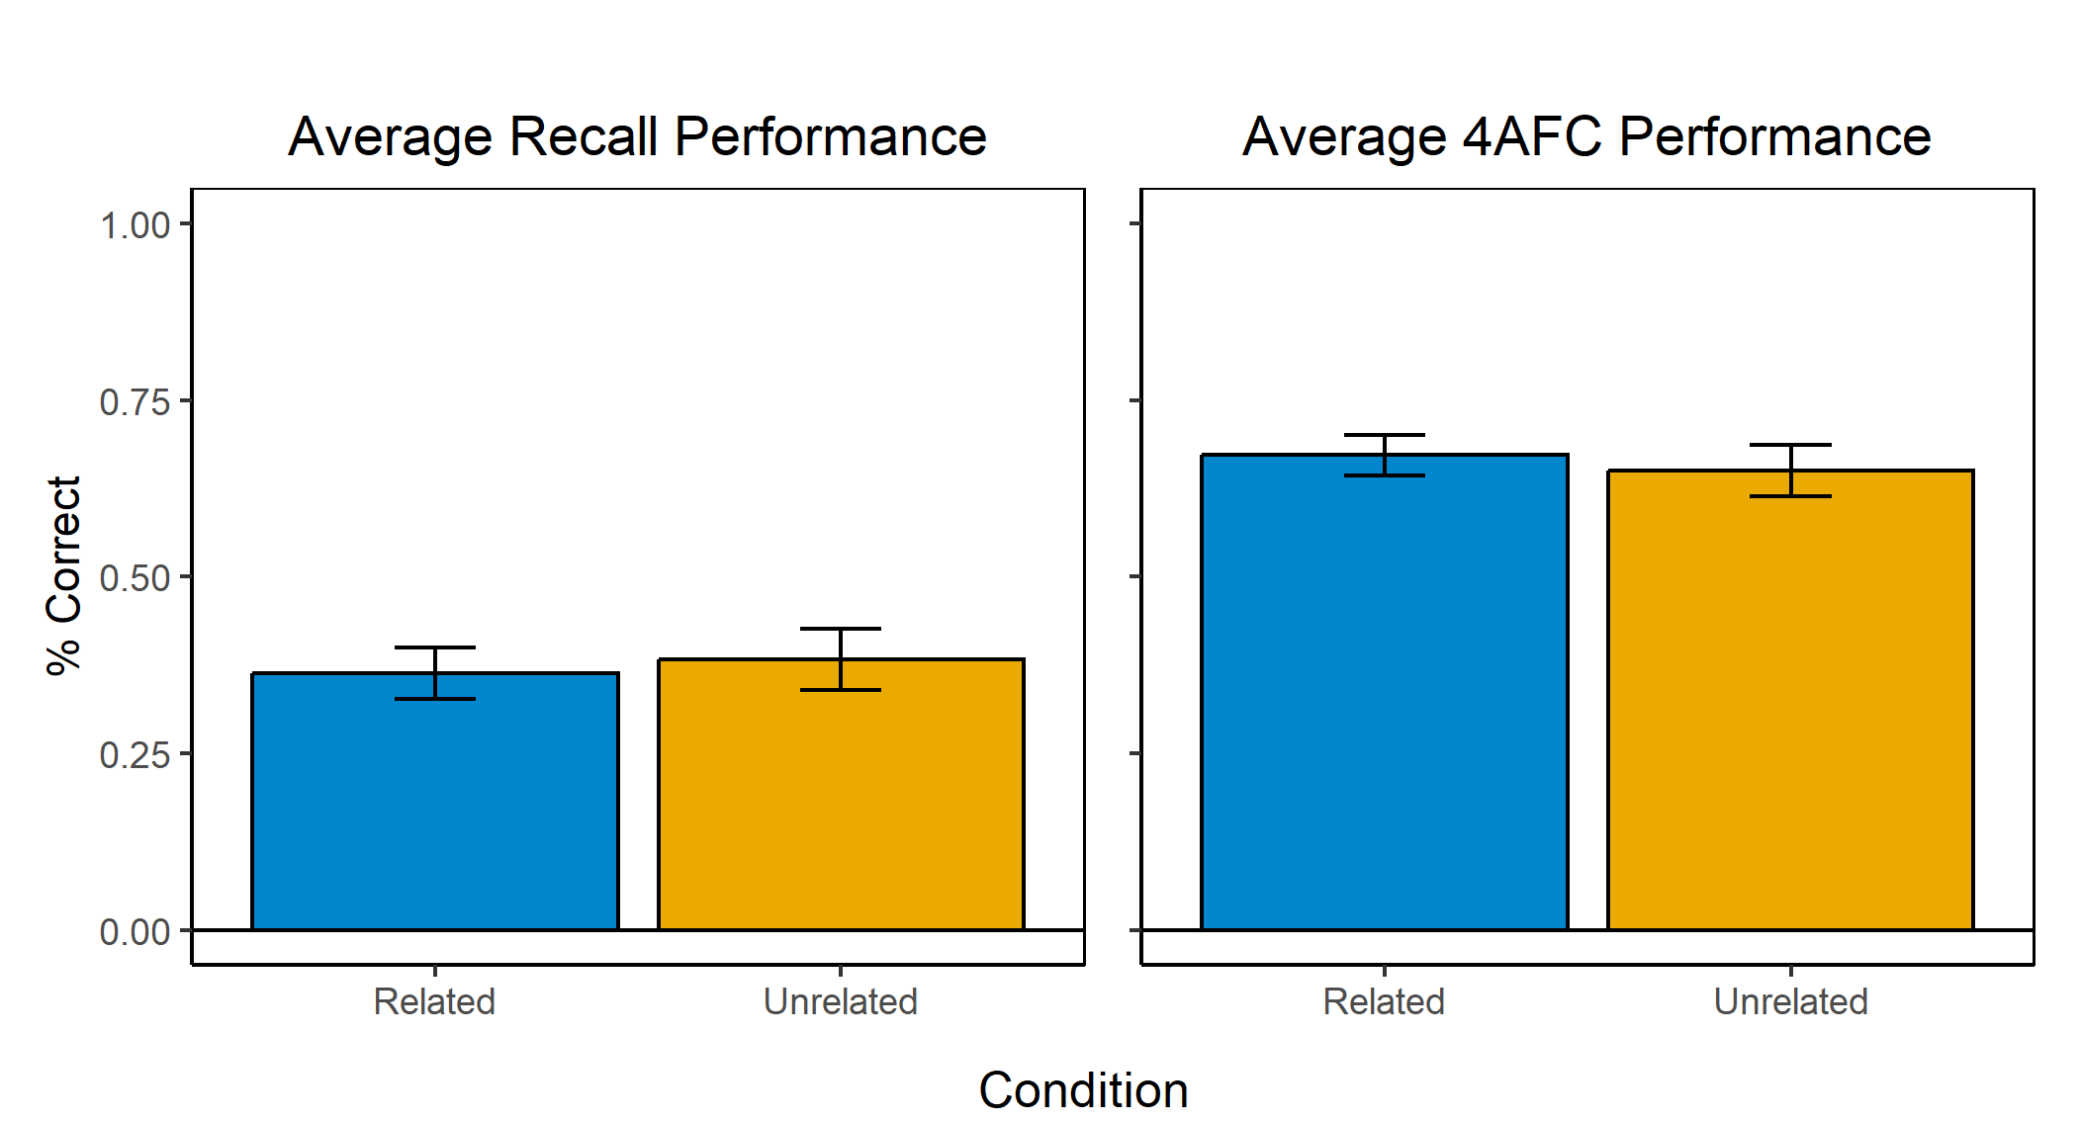
Memory Performance
Both Related (M = 0.36) and Unrelated Cues (M = 0.38) conditions had similar overall levels of cued recall accuracy.
t(74) = 0.34, p = 0.73, d = 0.09
Both Related (M = 0.67) and Unrelated (M = 0.65) Cues conditions also had similar 4AFC accuracy.
t(74) = 0.48, p = 0.64, d = 0.11
Notes:
These are optional notes.

Slide 15
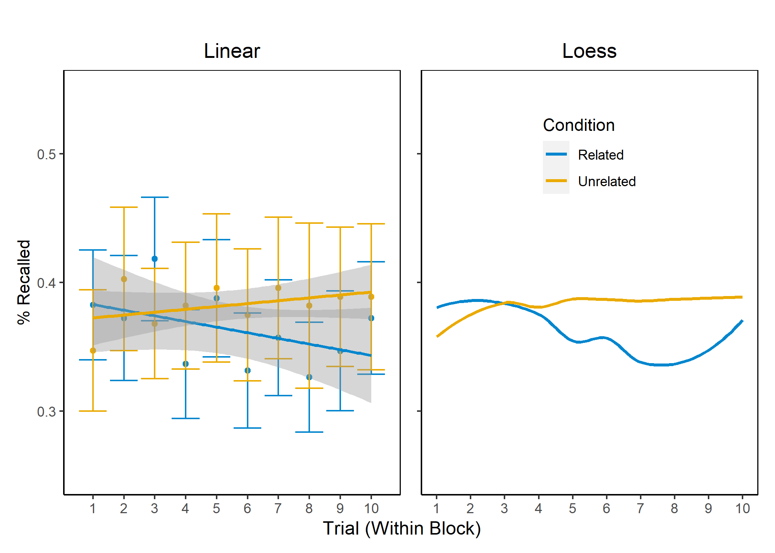
Output Interference
Notes:
These are optional notes.

Slide 16
CONCLUSIONS

